Slide 1
Spark SQL Streaming (Structured Streaming)

Slide 2
Agenda
Spark Streaming
What is Spark Streaming and How does it work?
Spark Streaming Programming Model
A small example
Structured Steaming
Use case: IoT Device Monitoring
Issues of Spark Streaming(DStreams)
Structured Streaming – Processing Modes
Single API – Dataset/DataFrame
How to define source
Transformations in Structured Steaming
Sinks

Slide 3


Slide 4
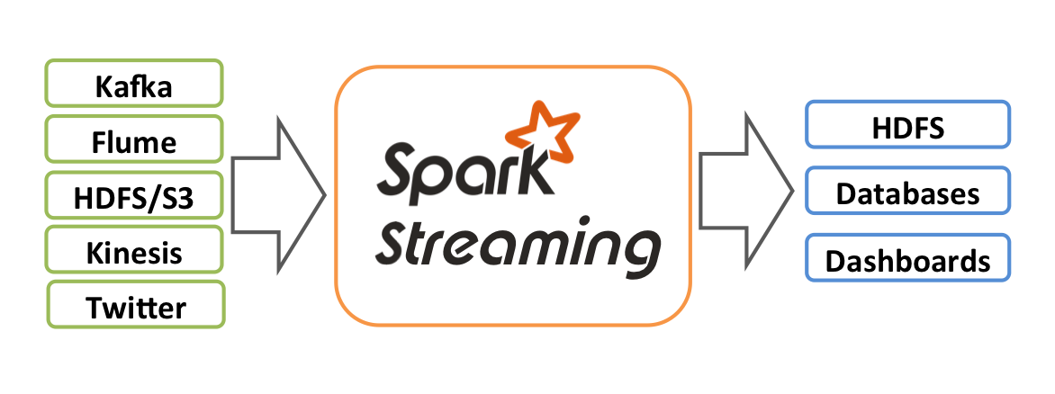
What is Spark Streaming?
Receive data streams from input sources, process them in a cluster, push out to databases/ dashboards
Scalable, fault-tolerant, second-scale latencies

Slide 5
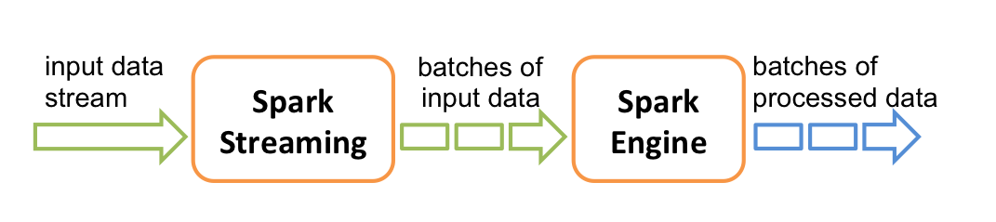
How does Spark Streaming work?
Chop up data streams into batches of few secs
Spark treats each batch of data as RDDs and processes them using RDD operations
Processed results are pushed out in batches

Slide 6
Spark Streaming Programming Model
Discretized Stream (DStream)
Represents a stream of data
Implemented as a sequence of RDDs
DStreams API very similar to RDD API
Functional APIs in Scala, Java, Python
Create input DStreams from different sources
Apply parallel operations

Slide 7
Lab / Demo
Exercise 00 DStream Network Word count

Slide 8
Use case: IoT Device Monitoring
Anomaly detection
Learn models offline
Use online + continues learning
events stream
IoT events from Kafka
ETL process into long term storage
Performs Data Enrichment
Processing Feature Extraction
Prevent data loss
Prevent duplicates
Status monitoring
Aggregate on Windows on event time for DE and FE
Handle late data
Interactively debug issues
consistency

Slide 9
Pain points with Spark Streaming(DStreams)
Processing with event-time, dealing with late data
DStream API exposes batch time, hard to incorporate event-time
2. Interoperate streaming with batch AND interactive
RDD/DStreams has similar API, but still requires translations
3. Reasoning about end-to-end guarantees
Requires carefully constrictions sinks that handle failures correctly
Data consistency in the storage while being updated

Slide 10
Structured streaming

Slide 11
The simplest way to perform streaming analytics is not having to reason about streaming at all

Slide 12
Structured Streaming – Processing Modes
Input: data from source as an append-only table
Trigger: how frequently to check input for new data
Query: operations on input usual map/filter/reduce new window, session ops

Slide 13
Structured Streaming – Processing Modes
Result: final operated table updated every trigger interval
Output: what part of result to write to data sink after every trigger
Complete output: Write full result table every time

Slide 14
Structured Streaming – Processing Modes
Result: final operated table updated every trigger interval
Output: what part of result to write to data sink after every trigger
Complete output: Write full result table every time
Delta output: Write only the rows that changed in result from previous batch
Append output: Write only new rows
*Not all output modes are feasible with all queries

Slide 15
API – Dataset/DataFrame

Slide 16
Anatomy of a Steaming Query Streaming word count

Slide 17
Anatomy of a Streaming Query: Step 0
Spark Session
Use common entry point SparkSession to create streaming
Specify configurations
from pyspark.sql import
SparkSession spark = SparkSession
.builder
.appName("Python Spark SQL basic example")
.config("spark.some.config.option", "some-value")
.getOrCreate()

Slide 18
Anatomy of a Streaming Query: Step 1
Source
Specify one or more locations to read data from
Built in support for Files/Kafka/Socket, pluggable.
SparkSession spark = SparkSession…
spark.readStream .format("kafka") .option("subscribe", "input") .load()

Slide 19
Anatomy of a Streaming Query: Step 2
from pyspark.sql import Trigger SparkSession spark = SparkSession…
spark.readStream .format("kafka") .option("subscribe", "input") .load() .groupBy("value.cast("string") as key") .agg(count("*") as "value")
Transformation
Using DataFrames, Datasets and/or SQL.
Internal processing always exactly- once.

Slide 20
Anatomy of a Streaming Query: Step 3
from pyspark.sql import Trigger SparkSession spark = SparkSession…
spark.readStream .format("kafka") .option("subscribe", "input") .load() .groupBy("value.cast("string") as key") .agg(count("*") as "value") .writeStream() .format("kafka") .option("topic", "output") .outputMode(OutputMode.Complete()) .option("checkpointLocation", "...") .start()
Sink
Accepts the output of each batch.
When supported sinks are transactional and exactly once (Files).

Slide 21
Anatomy of a Streaming Query: Output Modes
from pyspark.sql import Trigger
SparkSession spark = SparkSession…
spark.readStream .format("kafka") .option("subscribe", "input") .load() .groupBy("value.cast("string") as key") .agg(count("*") as "value") .writeSteam() .format("kafka") .option("topic", "output") .trigger(" 1 minute") .outputMode("update") .option("checkpointLocation", "...") .start()
Output mode – What's output
Complete – Output the whole answer every time
Update – Output changed rows
Append– Output new rows only
Trigger – When to output
Specified as a time, eventually supports data size
No trigger means as fast as possible

Slide 22
Anatomy of a Streaming Query: Checkpoint
from pyspark.sql import Trigger SparkSession spark = SparkSession… spark.readStream .format("kafka") .option("subscribe", "input") .load() .groupBy("value.cast("string") as key") .agg(count("*") as "value") .writeSteam() .format("kafka") .option("topic", "output") .trigger(" 1 minute") .outputMode("update") .option("checkpointLocation", "...") .start()
Checkpoint
Tracks the progress of a query in persistent storage
Can be used to restart the query if there is a failure.
trigger( Trigger. Continunous(“ 1 second”))

Slide 23
Lab / Demo
Exercise 01 Network Word count
Exercise 02 Kafka Word count
Exercise 03

Slide 24
Underneath the Hood

Slide 25
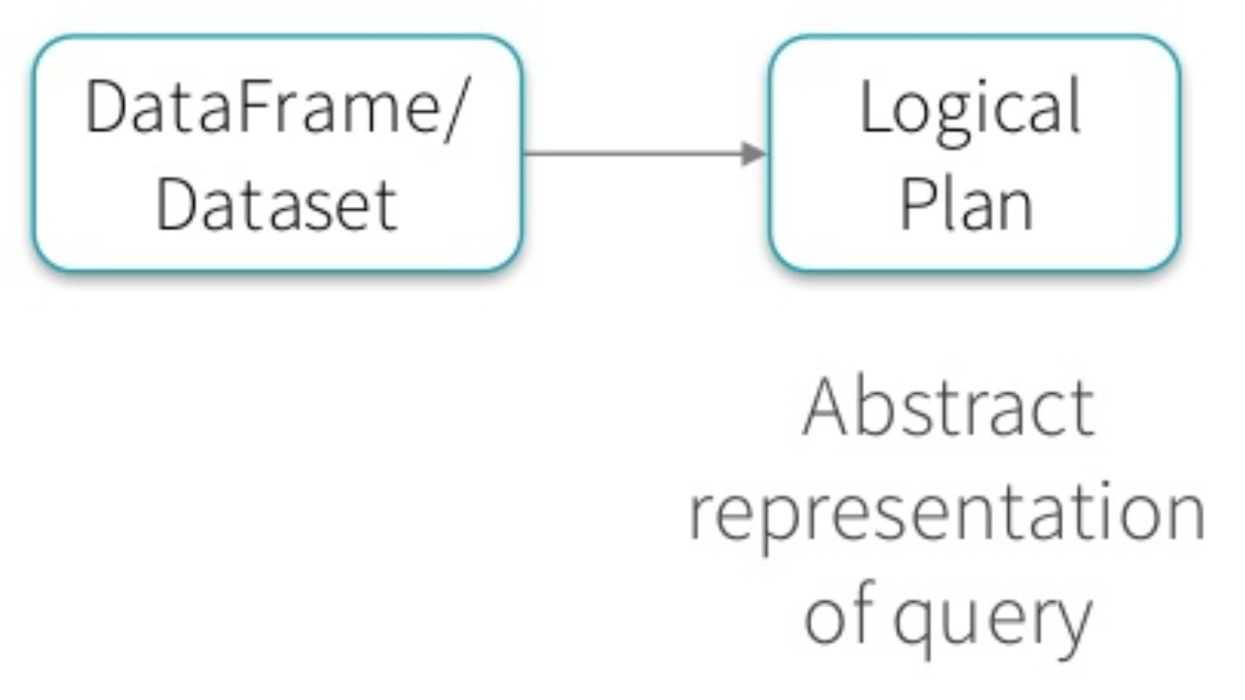
Batch Execution on Spark SQL

Slide 26
Batch Execution on Spark SQL

Slide 27
Batch Execution on Spark SQL

Slide 28
Batch Execution on Spark SQL

Slide 29
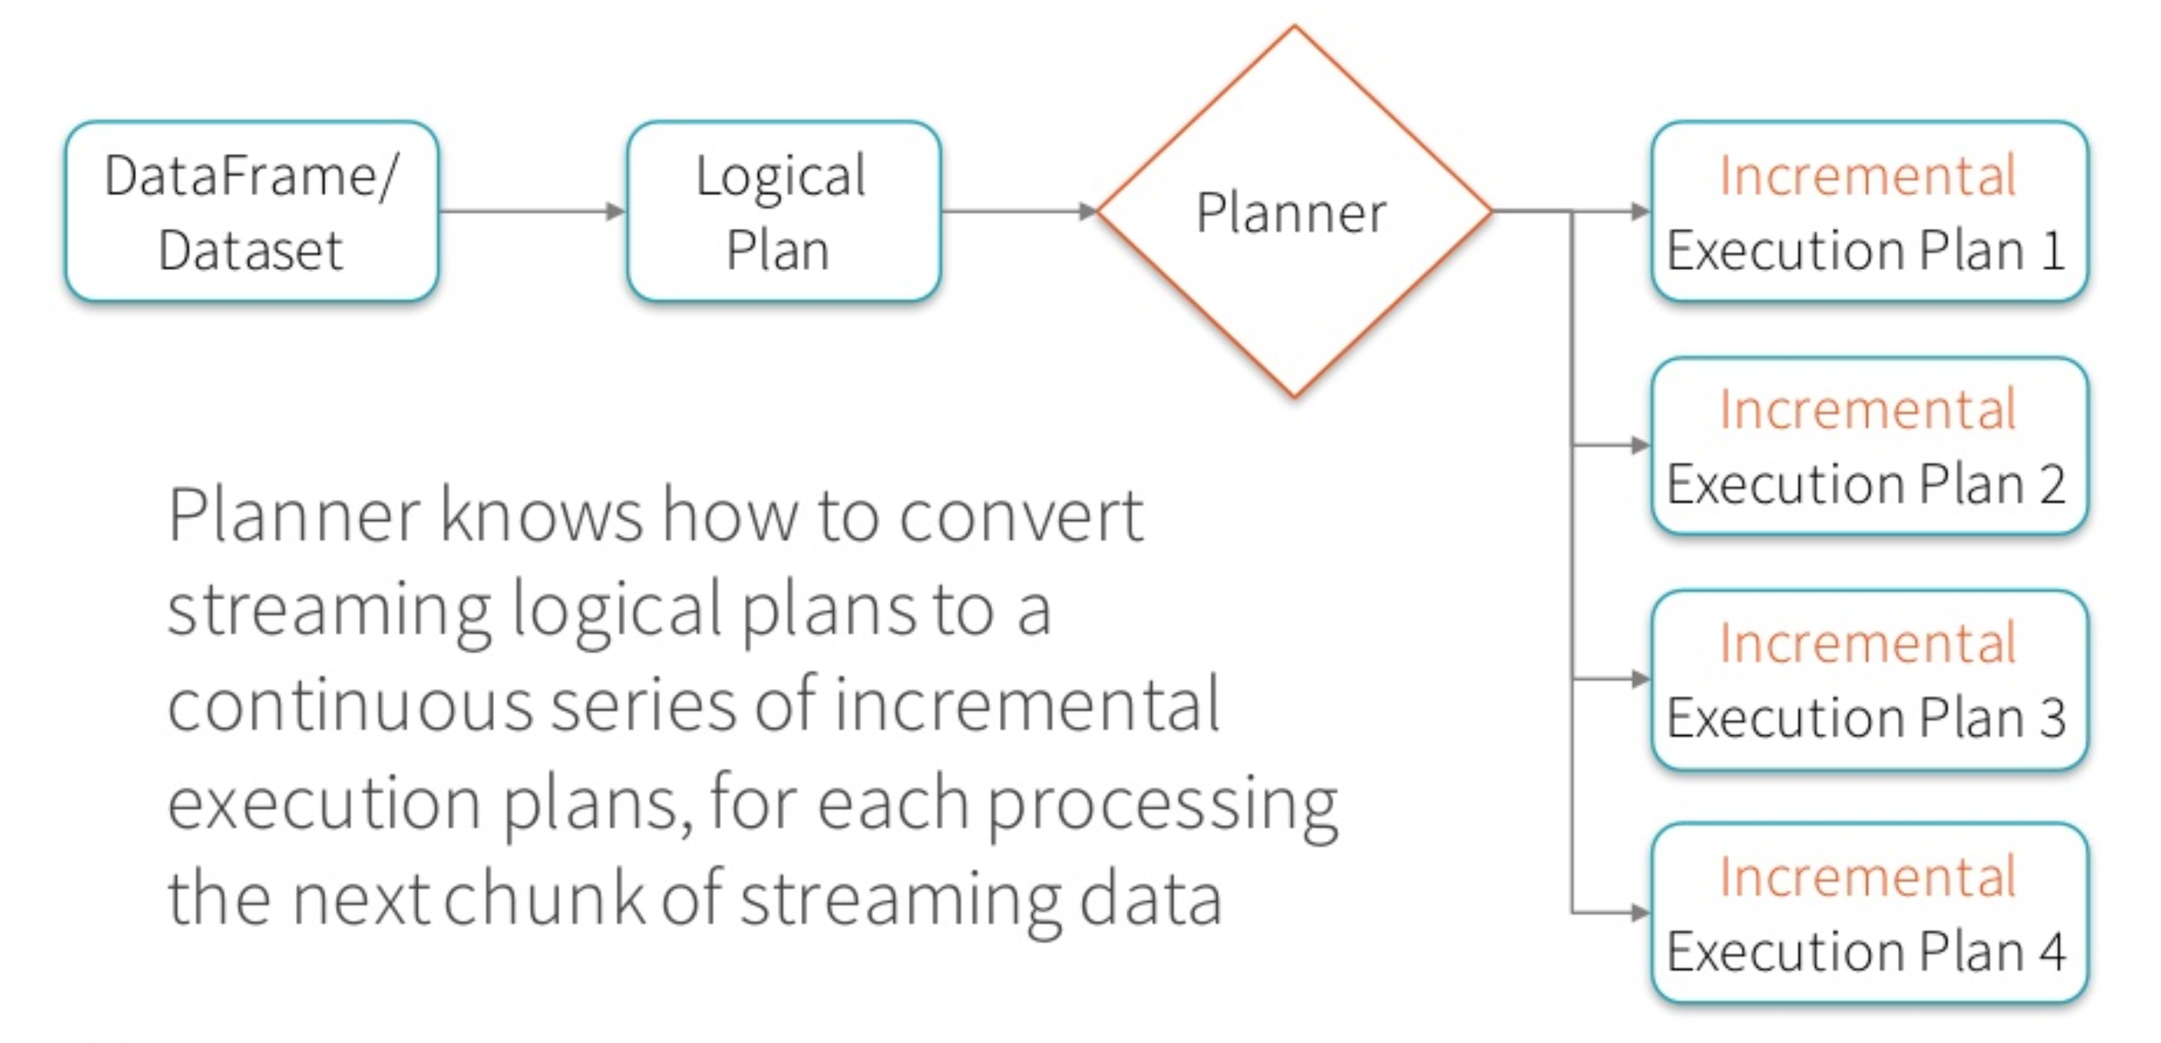
Continues Incremental Execution

Slide 30
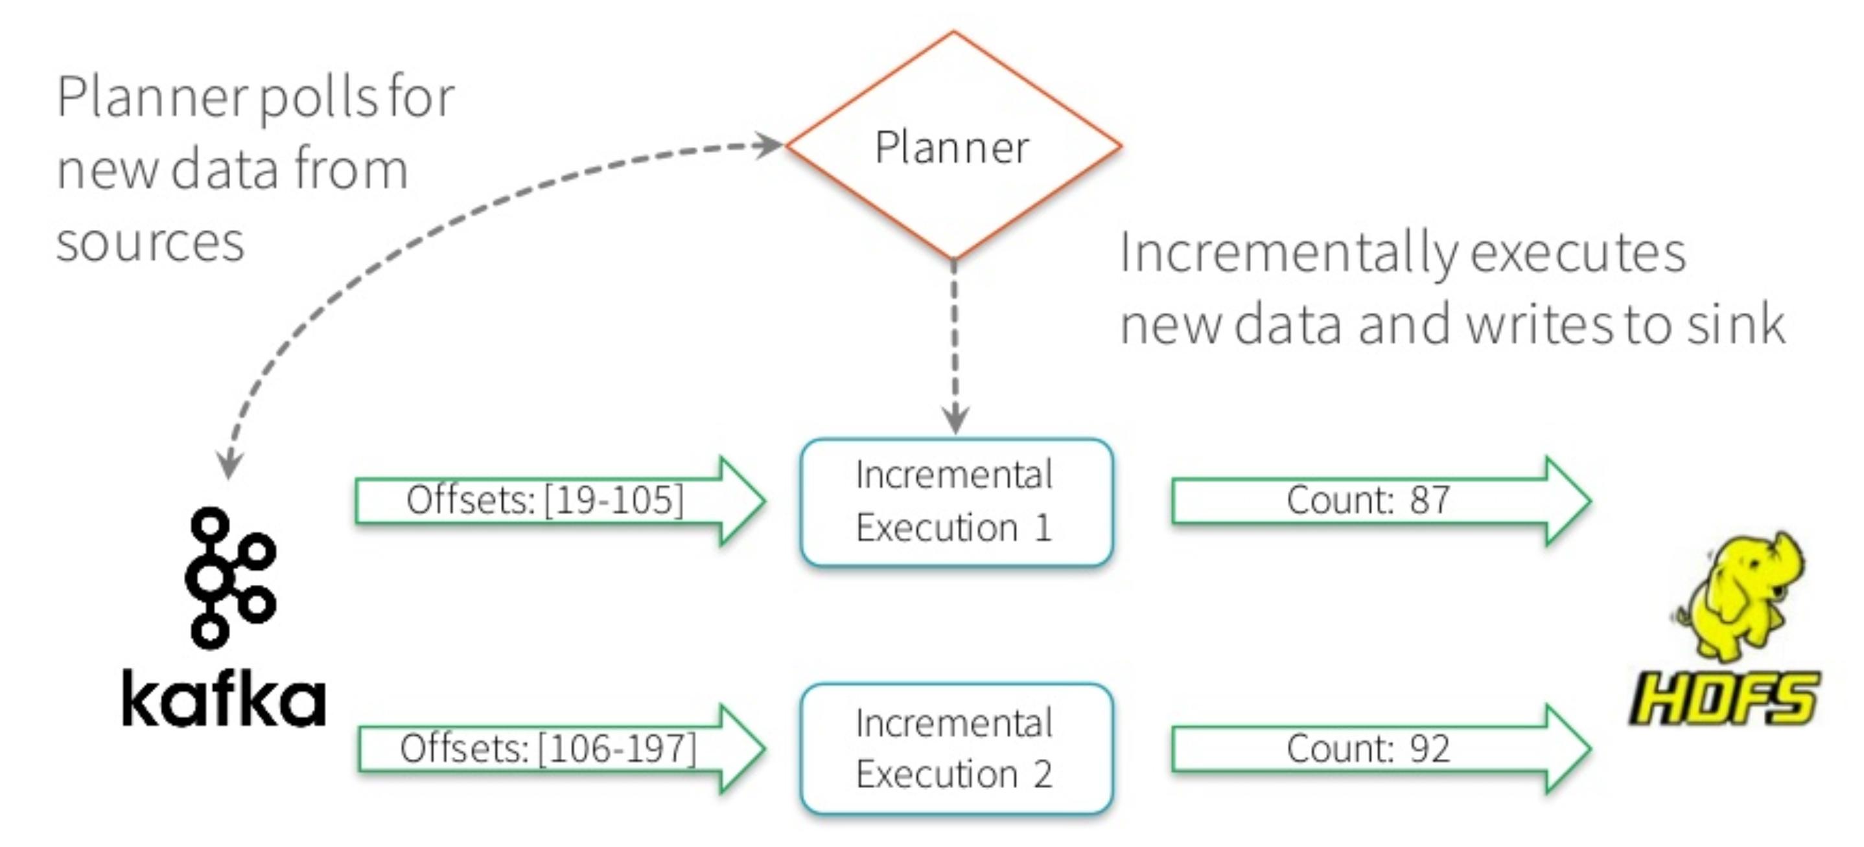
Continues Incremental Execution

Slide 31
Continues Incremental Execution

Slide 32
Complex Structured Streaming

Slide 33
Event Time
Many use cases require aggregate statistics by event time
E.g. what's the #errors in each system in the 1 hour windows?
Many challenges
Extracting event time from data, handling late, out-of-order data
DStream APIs were insufficient for event-time stuff

Slide 34
Event Time Aggregations
Windowing is just another type of grouping in Struct.
Streaming
number of records every hour
parsedData .groupBy(window("timestamp","1 hour")) .count()
avg signal strength of each device every 10 mins
parsedData .groupBy( "device", window("timestamp","10 mins")) .avg("signal")
Support UDAFs!

Slide 35
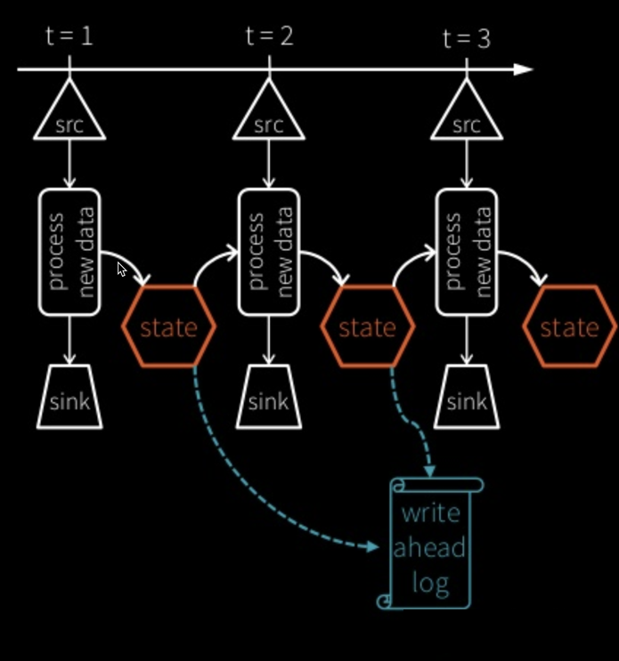
Stateful Processing for Aggregations
Aggregates has to be saved as distributed state between triggers
Each trigger reads previous state and writes updated state
State stored in memory, backed by write ahead log in HDFS/S3
Fault-tolerant, exactly-once guarantee!

Slide 36
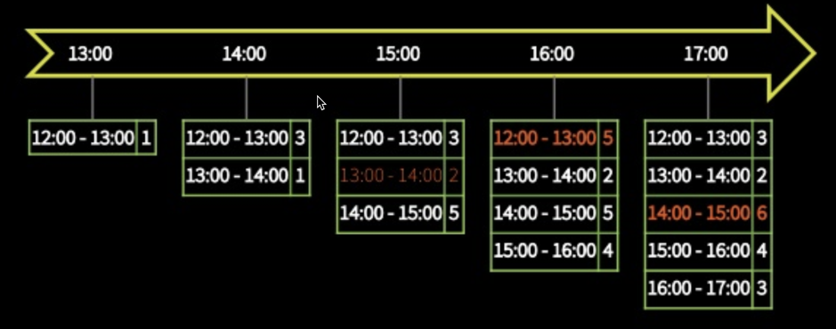
Automatically handles Late Data
Keeping state allows late data to update counts of old windows red = state updated with late data
But size of the state increases indefinitely if old windows are not dropped
Red = state updated with late data

Slide 37
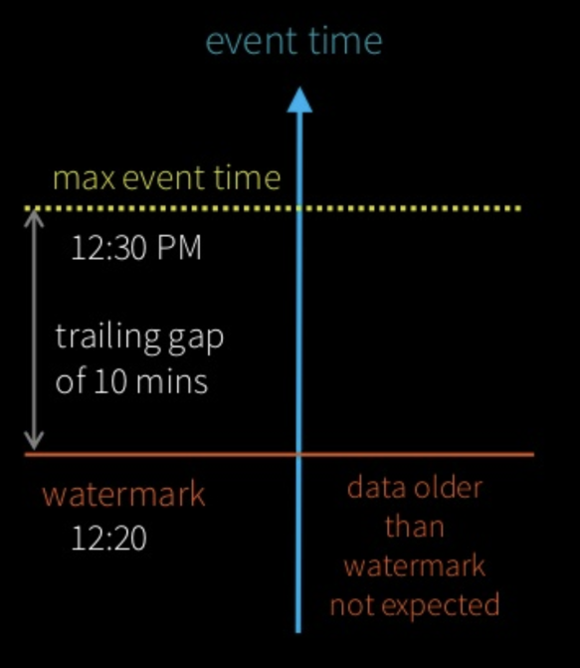
Watermarking
Watermark - moving threshold of how late data is expected to be and when to drop old state
Trails behind max event time seen by the engine
Watermark delay = trailing

Slide 38
Watermarking
Watermark - moving threshold of how late data is expected to be and when to drop old state
Trails behind max event time seen by the engine
Watermark delay = trailing

Slide 39
Watermarking
Data newer than watermark may be late, but allowed to aggregate
Data older than watermark is "too late" and dropped
Windows older than watermark automatically deleted to limit the amount of intermediate state
event time
max event time
watermark
Data older than watermark not expected

Slide 40
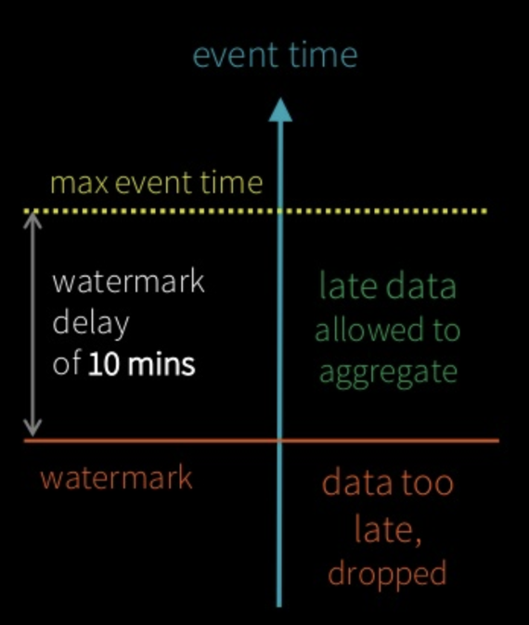
Watermarking
parsedData .withWatermark("timestamp", "10 minutes") .groupBy(window("timestamp","5 minutes")) .count()
Useful only in stateful operations
Ignored in non-stateful streaming queries and batch queries watermark delay of 10 mins

Slide 41
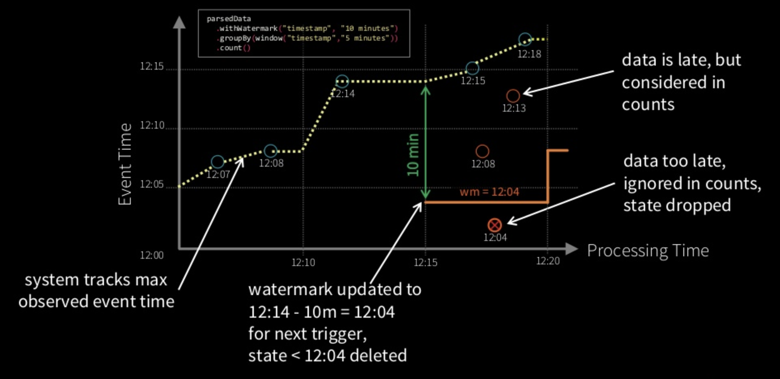
Watermarking

Slide 42
Clean separation of concerns
Query Semantics
How to group data by time? (same for batch & streaming)
Processing Details
How late can data be?
How often to emit updates?
parsedData .withWatermark("timestamp", "10 minutes") .groupBy(window("timestamp","5 minutes")) .count() .writeStream .trigger("10 seconds") .start()

Slide 43
Other Interesting Operations
Streaming Deduplication
Watermarks to limit state
Joins
Stream-batch joins supported, stream-stream joins coming in 2.3
Arbitrary Stateful Processing [map|flatMap]GroupsWithState
parsedData.dropDuplicates("eventId")
parsedData.join(batchData, "device")
ds.groupByKey(_.id) .mapGroupsWithState (timeoutConf) (mappingWithStateFunc)

Slide 44
Monitoring Streaming Queries
Get last progress of the streaming query
Current input and processing rates
Current processed offsets
Current state metrics
Get progress asynchronously through by registering your own StreamingQueryListener new StreamingQueryListener
{ def onQueryStart(...) def onQueryProgress(...) def onQueryTermination(...) } streamingQuery.lastProgress() { ... "inputRowsPerSecond" : 10024.225210926405, "processedRowsPerSecond" : 10063.737001006373, "durationMs" : { ... }, "sources" : [ ... ], "sink" : { ... } ... }

